Slide 1
Disaster Preparedness and Response Education System for Schools and Colleges
CSE7302- University Project
Review-1
Batch Number: IST_6
Under the Supervision of,
Dr. Poornima S
Assistant Professor
School of Computer Science and Engineering
Presidency University
ROLL NUMBER | NAME
20221IST0036 | VARSHA B
20221IST0034 | MOUNIKA.M
20221IST0007 | MALLAKALUVA HEMANTH REDDY
Name of the Program: B.TECH
Name of the HoD: Dr.Pallavi R
Name of the Program Project Coordinator: Ms. Benitha Christinal J
Name of the School Project Coordinators: Dr. Sampath A K , Dr. Geetha A

Slide 2
Problem Statement Number: SIH25008
Organization: Government of Punjab
Category (Hardware / Software / Both) : Software
Problem Description:In India, schools and colleges are often unprepared for natural disasters such as earthquakes, floods, and fires. While emergency guidelines exist on paper, there is a lack of structured disaster management education integrated into the curriculum. Institutions lack digital tools to simulate disaster scenarios or conduct virtual drills to train students and staff on safety protocols.Furthermore, there’s a gap in localized awareness—many students are unaware of how to react during disasters specific to their region. Manual drills, where they occur, are infrequent and often poorly coordinated, failing to instill practical preparedness.

Slide 3
Objectives
To develop a digital disaster preparedness education system for schools and colleges
To provide interactive learning modules for multiple disaster types
To enable virtual drills and disaster simulations
To deliver region-specific disaster alerts and safety instructions
To assist institutions in tracking preparedness levels and drill participation

Slide 4
Background and Related Work
Background
India ranks high in global disaster vulnerability indexes. However, disaster education in schools and colleges is limited to theory or occasional awareness programs. Students and staff lack hands-on training and real-time guidance mechanisms during emergencies. There is a strong need for an integrated, technology-driven disaster preparedness system that can educate, simulate, and guide users effectively.
Related Work
Existing disaster management systems focus mainly on post-disaster response rather than preparedness education. Some platforms provide static content or manuals, while others focus on government-level response systems. These solutions do not cater specifically to educational institutions and lack interactive learning, simulations, and preparedness analytics. Research suggests that digital and simulation-based disaster education significantly improves emergency response efficiency.

Slide 5
Analysis of Problem Statement
ANALYSIS OF THE PROBLEM
Lack of structured disaster preparedness education in institutions
Low student engagement with traditional awareness programs
Absence of virtual drills and simulations
No centralized system for monitoring preparedness levels
Poor region-specific disaster awareness
PROPOSED SOLUTION
Provide interactive disaster-specific learning modules
Conduct virtual drills and simulated emergency scenarios
Enable real-time alerts and safety instructions
Provide dashboards for institutional preparedness monitoring
Develop a digital disaster preparedness education platform

Slide 6
Analysis of Problem Statement (contd…)
Technology Stack Components:
Frontend: HTML, CSS, JavaScript
Backend: Python (Flask / Django)
Database: MySQL / SQLite
Notification Services: Firebase / Email / SMS
Deployment: Cloud-based hosting

Slide 7
Analysis of Problem Statement (contd...)
Software Requirements:
Operating System: Windows / Linux / macOS
Programming Language: Python 3.x
Backend Framework: Flask / Django
Frontend Technologies: HTML, CSS, JavaScript
Database: MySQL / SQLite
Development Tools: VS Code, GitHub
Web Browser: Chrome / Edge / Mobile Browser

Slide 8
SDG Mapping
SDG 9 – Industry, Innovation and Infrastructure
This project aligns with SDG 9 by promoting innovative digital infrastructure for disaster preparedness education.
The proposed system leverages software-based learning platforms to strengthen institutional preparedness and resilience.
By using technology to educate students and institutions on disaster response, the system supports the development of reliable, sustainable, and resilient infrastructure.
It encourages innovation in disaster risk education and enhances the ability of educational institutions to respond effectively during emergencies.

Slide 9
Innovation or Novel Contributions
Interactive disaster preparedness education platform
Virtual disaster drills and simulations
Region-specific disaster awareness and alerts
Gamified learning to improve engagement
Institutional preparedness analytics dashboard
Scalable and low-cost solution for schools and colleges

Slide 10
Github Link
Repository Link:
https://github.com/hemanthredddy2003/prepwise-disaster-edu

Slide 11
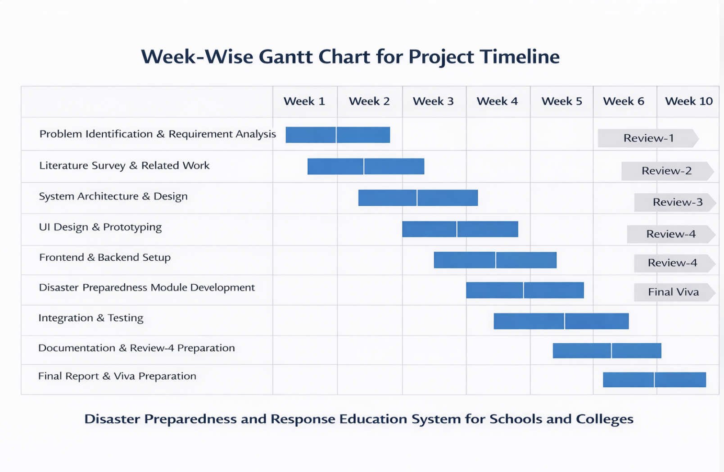
Timeline of the Project (Gantt Chart)

Slide 12
References (IEEE Paper format)
[1] National Disaster Management Authority (NDMA), School Safety Guidelines, Government of India, New Delhi, India, 2016.
[2] United Nations Office for Disaster Risk Reduction (UNDRR), Disaster Risk Reduction in Education: A Global Framework, United Nations, Geneva, Switzerland, 2017.
[3] A. Shaw, R. Sharma, and P. Gupta, “Integrating disaster preparedness education in schools using digital platforms,” IEEE Access, vol. 9, pp. 112345–112356, 2021.
[4] R. Pratiwi, “Developing an education support system for disaster management through an ethnoscience-based digital disaster learning module,” Int. J. Disaster Risk Reduct., vol. 100, Jan. 2024.
[5] K. X. Author, “National School Safety Policy and disaster preparedness in educational institutions,” Govt. of India Report, 2024.

Slide 13


